Slide 1




AT82.02
Data Modeling and Management
Unit 2-3: Column Family Model
Chutiporn Anutariya (chuti at ait dot ac dot th)

Slide 2
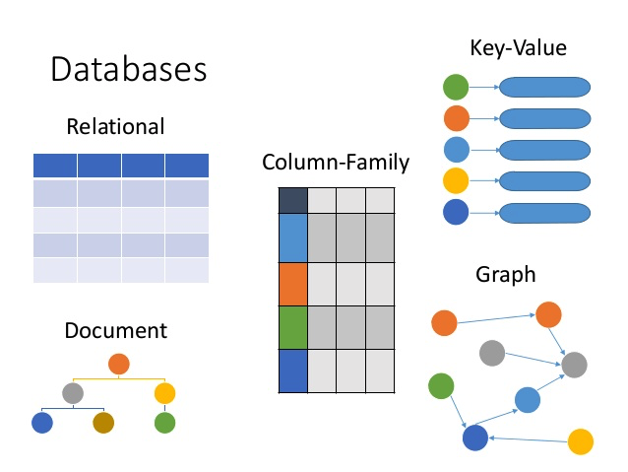
Database Family
RECAP

Slide 3
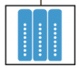
Column-Family Model
(aka. Columnar and Wide-column Model)
Note: Most terminology used here are based on Apache Cassandra since it is one of the most popular column-family stores.

Slide 4
Column-Family Model
Column-family stores enhance the key-value concept by providing additional structure.
One of the most influential NoSQL database was Google’s BigTable.
Other stores: Cassandra, HBase, Hypertable, Amazon DynamoDB.

Slide 5
Column-Family Model
Most RDB databases has rows as unit of storage, which helps in writing performances.
In practical use, it has shown to be more efficient for optimizing read operations to store the data in relational tables not per row, but per column.
This is because all columns in one row are rarely needed at once, but there are groups of columns that are often read together.
Therefore, in order to optimize access, it is useful to structure the data in such groups of columns—column families—as storage units.
Notes:
Column-family stores, which are named after this method, follow this model; they store data not in relational tables, but in enhanced and structured multidimensional key spaces.

Slide 6
Column-Family Model
Columns can be grouped to column families to support organization and partitioning.
When you place related columns in the same family, instances of those columns will be stored as physically close to each other as possible.

Slide 7



Popular Column-Family Stores
Cassandra
HBase
BigTable
It uses a concept called keyspace, which works in a similar way to a relational model scheme.
Each column is treated separately;
They have high performance in aggregation queries (SUM, COUNT, AVG, MIN) since the data is available in one column;
Widely used to manage data warehouses, business intelligence, CRM, card catalogs from the Library

Slide 8
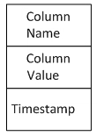
Column
Key is the Column Name with an associated value.
A column in a certain implementation may have an additional field called timestamp.
A column can be considered like a Key-Value pair:
Source: https://www.codeproject.com/Articles/518134/CassandraplusChapterplusThreeplus-e2-80-93plusData
Notes:
The simplest unit of storage is the column itself consisting of a name-value pair. Any number of columns can then be combined into a super column, which gives a name to a particular set of columns. Columns are stored in rows, and when a row contains columns only, it is known as a column family, but when a row contains super columns, it is known as a super column family.
At first it might seem odd to include rows when the data is mostly organized via columns, but in fact, rows are vital since they provide a nested hashmap for columnar data. Consider the diagram below of a super column family mapping out a recording artist and his albums.

Slide 9
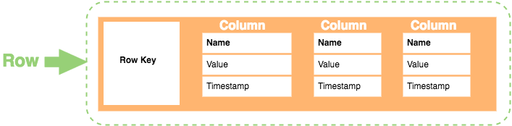
Column Family Data Model
Row Key: Each row has a unique key, which is a unique identifier for that row.
Column: Each column contains a name, a value, and timestamp.
Name: the name of the name/value pair.
Value: the value of the name/value pair.
Timestamp: provides the date and time that the data was inserted, which can be used to determine the most recent version of data.
src: https://database.guide/what-is-a-column-store-database/

Slide 10
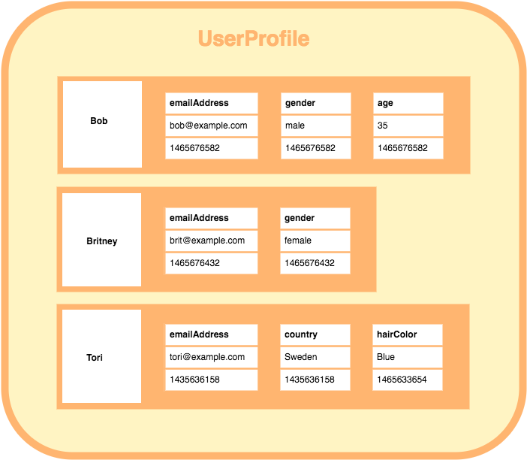
Example: A Column Family with 3 rows

Slide 11
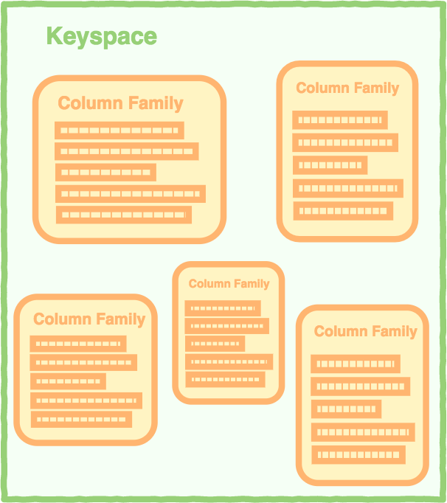
Keyspace

Slide 12
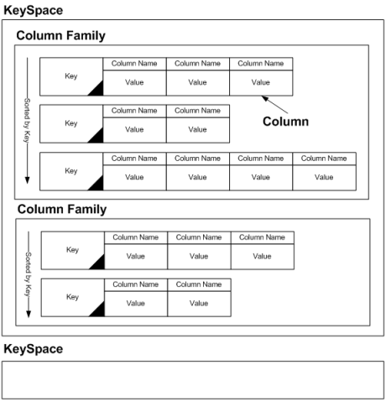
KeySpace

Slide 13
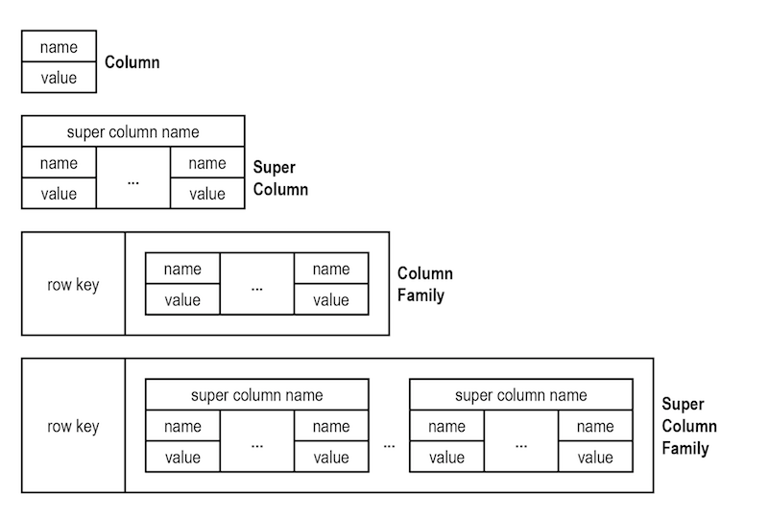
Four Building Blocks of Column Family Model
Figure source: https://neo4j.com/blog/aggregate-stores-tour/
Notes:
The simplest unit of storage is the column itself consisting of a name-value pair. Any number of columns can then be combined into a super column, which gives a name to a particular set of columns. Columns are stored in rows, and when a row contains columns only, it is known as a column family, but when a row contains super columns, it is known as a super column family.
At first it might seem odd to include rows when the data is mostly organized via columns, but in fact, rows are vital since they provide a nested hashmap for columnar data. Consider the diagram below of a super column family mapping out a recording artist and his albums.

Slide 14
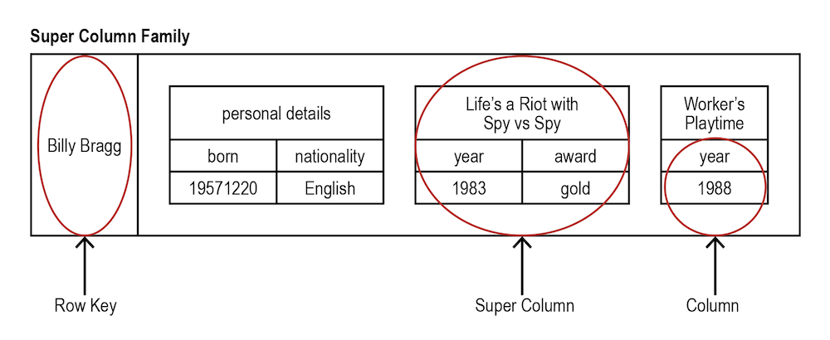
Storing Data in a Super Column Family
Figure source: https://neo4j.com/blog/aggregate-stores-tour/
Notes:
The simplest unit of storage is the column itself consisting of a name-value pair. Any number of columns can then be combined into a super column, which gives a name to a particular set of columns. Columns are stored in rows, and when a row contains columns only, it is known as a column family, but when a row contains super columns, it is known as a super column family.
At first it might seem odd to include rows when the data is mostly organized via columns, but in fact, rows are vital since they provide a nested hashmap for columnar data. Consider the diagram below of a super column family mapping out a recording artist and his albums.

Slide 15
Static vs. Dynamic Column Family
Static Column Family
We can specify schema such as Column Names, their Data Types and indexes
Rows are not required to reserve storage for every column defined in the schema and can be sparse.
Space is only used for the columns that are present in the row.
Dynamic Column Family
There is no schema. The application is free to store whatever columns it wants and their data types at run-time.

Slide 16
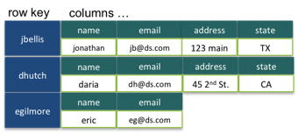
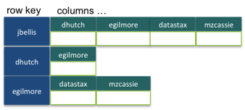
Static vs. Dynamic Column Family

Slide 17
Summary
Keyspace: Top level container for Column Families
Column Family: A container for Row Keys and Column Families
Row Key: The unique identifier for data stored within a Column Family
Super Column: A Dictionary of Columns identified by Row Key
Column: Name-Value pair with an additional field: timestamp

Slide 18
Row-oriented vs. Column-oriented
However, there are many scenarios where:
Write are rares, but
You need to read a few columns of many rows at once
Most RDB databases has rows as unit of storage, which helps in writing performances.

Slide 19
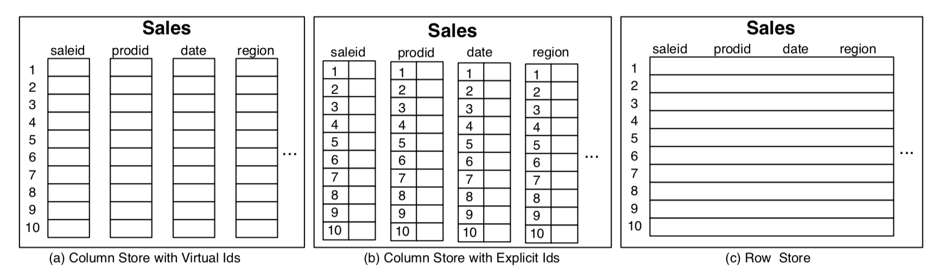
Row-oriented vs. Column-oriented

Slide 20
Benefits & Limitations
The biggest benefit of a column-oriented database is fast data aggregation:
Extracting data from a single column and providing summaries of that data.
Google uses one, for example, to aggregate Web page visitation data. When the software has compiled the Web sites visited and the number of times each was visited, the data are archived.

Slide 21
Benefits & Limitations
Unlike transactional data, which is written frequently, analytical data doesn't change often. It's usually created by infrequent bulk writes – data dumps.
Columnar store lets you ignore all data that do not apply to a particular query, because you can retrieve the information from just the columns you want.
To insert a new record in a row-oriented database, it takes a single operation.
However, it takes more computing resources to write a record to a columnar database, because you have to write all the fields to the proper columns one at a time.

Slide 22
Applications
Row-oriented databases are still the best choice for OLTP applications.
Column-oriented databases are generally better for OLAP.

Slide 23

P. Sadalage and M. Fowler: NoSQL Distilled: A Brief Guide to the Emerging World of Polyglot Persistence, Addison-Wesley Professional, 2013
Jan L. Harrington: Relational Database Design and Implementation, 4th edition, Morgan Kaufmann, 2016
A. Makris, K. Tserpesa, V. Andronikou Dimosthenis Anagnostopoulos: A Classification of NoSQL Data Stores Based on Key Design Characteristics, Procedia Computer Science, Vol. 97, 2016, pp. 94-103.

